Slide 1
Title: Optimizing inventory management using prescriptive analytics.

Slide 2
Table of Content
Project Overview
Objectives
Dataset Description
Exploratory Data Analysis(EDA)
Data Visualizations
Methodology
Results
Findings
Discussion
Limitations
Conclusion
Recommendations
References

Slide 3
Project Overview
Objective:
Investigate and evaluate a dataset on summer fashion items to understand trends, preferences, and performance.
Context:
Importance of informed decisions in the fashion industry, particularly with the rise of e-commerce.
Dataset includes product details, costs, ratings, and sales figures for comprehensive insights.
Analysis Focus:
Exploring product categories, pricing, customer feedback, and attribute impact on sales.
Identifying popular patterns and provide actionable insights for inventory and marketing plans.
Business Impact:
To enhance understanding of seasonal variations in customer decisions.
Empower businesses to optimize customer satisfaction, expand product offerings, and stay competitive in e-commerce.

Slide 4
Objectives
Determine Popular Summer Fashion Trends
Assess Pricing Strategies
Evaluate Customer Satisfaction
Examine Product Attributes
Recognize Shipping Dynamics
Find High-Performing Vendors
Discover Seasonal Urgency
Publish Actionable Insights
Contribute to Industry Knowledge

Slide 5
Dataset Description
Data Source:
Extracted from an extensive retail inventory with diverse product listings.
Data Structure:
Title: Product name.
Price: Selling price.
Retail_Price: Manufacturer's suggested retail price.
Currency_Buyer: Transaction currency.
Units_Sold: Total sales volume for each product.
Uses_Ad_Boosts: Indicator of advertisement boost usage.
Rating: Average product rating.
Rating_Count: Total number of ratings.
Merchant_Rating: Average rating of the seller.
Product_Id: Unique identifier for products.
Insights:
Encompasses pricing, product data, sales performance, and client feedback.
Key columns offer valuable insights into product listings and sales patterns.

Slide 6
Exploratory Data Analysis (EDA)
Price: Average: $8.33, Std Dev: $3.93.Range: $1.00 to $49.00, showcasing diverse pricing strategies.
Retail Price: Mean: $23.29, Std Dev: $30.36.Range: $1.00 to $252.00, indicating varied market positioning.
Sold Units: Average: 4,339 units, Std Dev: 9,357.Range: 1 to 100,000 units, highlighting product demand variability.
Rating: Mean: 3.82, Std Dev: 0.52.Range: 1.00 to 5.00, reflecting customer satisfaction levels.
Number of Ratings: Average: 890, Std Dev: 1,984.Range: 0 to 20,744, indicating diverse product engagement and popularity.
Merchant Evaluation: Average: 4.03, Std Dev: 0.20.Range: 2.33 to 5.00, influencing overall seller credibility in the e-commerce market.
Conclusion:
Quantitative insights into distribution and variability in key columns. Provides valuable knowledge about the dynamics of the summer fashion industry.

Slide 7
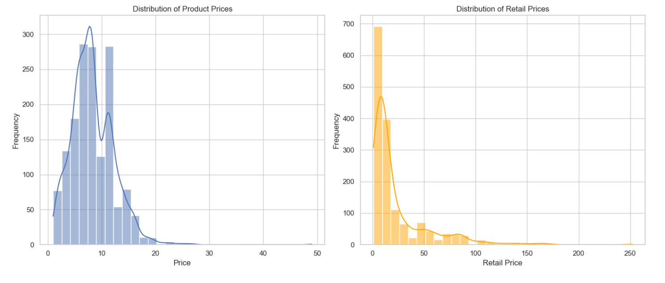
Data Visualization Distribution of Product Prices and Retail Prices
The distribution of product prices is displayed in the first plot. There is a concentration of products in the lower price range, as evidenced by the majority of products having prices under $20, peaking at $8.
The retail price distribution is depicted in the second plot. Like the selling prices, a large proportion of the products had retail pricing under $30, with a peak of about $10. This implies that the products are often priced between lower and mid-range.

Slide 8
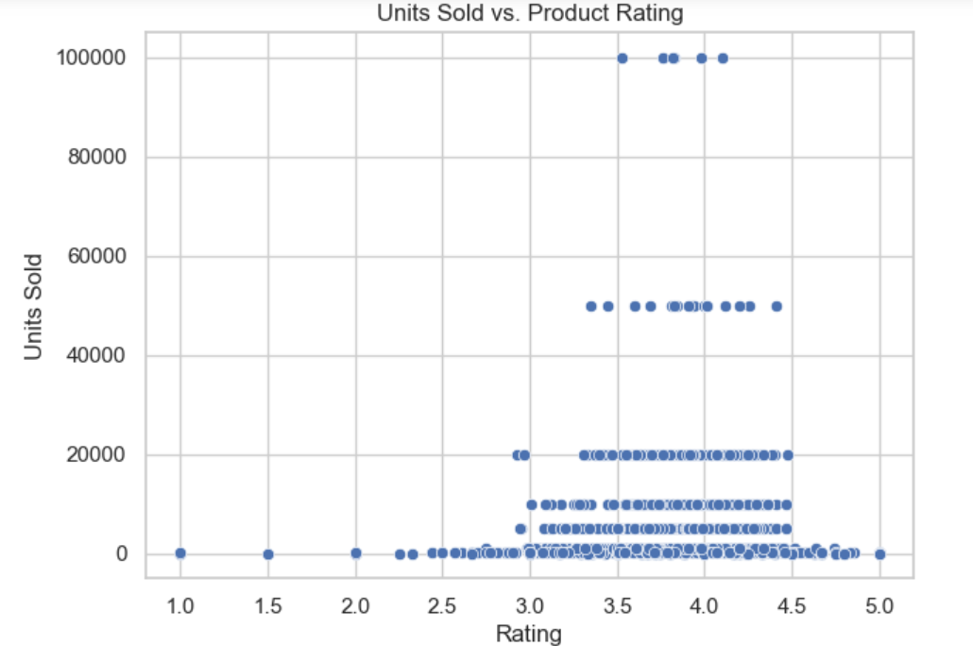
Units Sold vs Product Rating
In this visualization, we see the selling price distribution, with most products priced under $20, peaking at $8. This indicates our focus on budget-friendly options.
The second plot shows retail prices, mostly under $30, with a peak around $10, mirroring our selling price strategy and showing our competitive pricing range.
These insights are crucial for our inventory strategy, helping us set competitive prices while ensuring profitability. Now, let's see how these findings influence our inventory decisions

Slide 9
Methodology
Handling Missing Values
Outlier Handling
Data Analysis

Slide 10
Results
Inventory Model Summary
Assumptions Made:
Average lead time, holding costs, and ordering costs based on typical values.
Desired service level set at 95%.
Model Calculations:
Average Demand During Lead Time:
Calculated from historical sales data.
Safety Stock:
Determined using standard deviation of sales data and desired service level (converted to a z-score).
Reorder Point:
Sum of average demand during lead time and safety stock.
Results:
Average Demand During Lead Time:
Approximately 37,968 units.
Safety Stock:
Approximately 30,394 units.
Reorder Point:
Approximately 68,362 units.
Model Summary:
Basic framework for inventory optimization.
Can be a starting point, further refined with more specific data and advanced modeling techniques for real-world applications.

Slide 11
Findings
The project showcases the potential of data-driven strategies for inventory management optimization, setting the stage for more efficient and cost-effective retail operations.
The demand forecasting model's performance metrics guide future improvements for enhanced accuracy.

Slide 12
Discussion
Demand Forecasting Model:
Insight: Reliable accuracy with room for improvement.
Risk: Potential for overstocking or understocking.
Action: Calls for refining and enhancing the model for better precision.
Inventory Optimization Approach:
Outcome: Basic model establishes systematic reorder points.
Benefits: Mitigates stockouts and overstock situations, aligning with project goals.
Quantitative Basis: Computed reorder point aids in service level maintenance and holding cost reduction.
Data-Based Perspectives:
Discoveries: Insights into pricing, customer preferences, and sales patterns.
Strategic Advantage: Informed decisions on pricing and inventory.
Impact: Enhances customer satisfaction and refines stock management.
Compliance with Project Goals:
Achievement: Success in lowering stockouts and inventory costs.
Consideration: Emphasizes the need for ongoing improvement and adaptation to market changes.
Foundation: Lays the groundwork for sophisticated strategies in data-driven inventory management.
Conclusion:
The project significantly improves inventory management but highlights the complexity of retail sales. Continuous model development is essential for fully realizing the benefits of data-driven inventory optimization in the dynamic retail landscape.

Slide 13
Limitations
Dependence on Past Data:
Models limited by reliance on historical sales information.
Challenges in adapting to dynamic market conditions and changing consumer preferences.
Oversimplified Assumptions:
Inventory optimization model built on simplified lead times, holding costs, and ordering costs.
May not fully capture complexities and variations in real-world scenarios.
Dataset Limitations:
Issues with outliers, missing values, and potential data inaccuracies.
Generalizability restricted; customization required for different environments and product categories.
Real-Time Data Integration:
Models lack real-time data integration.
Limits prompt and effective responses to inventory management needs.

Slide 14
Conclusion
Achievements:
Demand Forecasting Model:
Applied Random Forest for insightful sales trend predictions.
Demonstrated the potential of machine learning in retail analytics.
Inventory Optimization Model:
Developed a fundamental model for methodical and data-driven inventory management.
Successfully achieved objectives of lowering inventory costs and minimizing stockouts.
Areas for Improvement:
Dynamic Retail Landscape:
Models faced challenges adapting to the rapidly changing retail environment.
Reliance on historical sales data limited adaptability.
Real-Time Data Integration:
Identified the need for incorporating real-time sales data.
Essential for creating flexible and responsive inventory strategies.
Summary:
Project showcased the practicality of machine learning and data analytics in inventory management.
Emphasized the necessity of continuous model development, improvement, and customization for specific retail environments.
Future enhancements crucial for fully realizing the potential of data-driven inventory optimization in the dynamic retail sector.

Slide 15
Recommendations
Future Inventory Management Focus:
Efforts to enhance the retail store's inventory management will concentrate on expanding the data framework and utilizing advanced predictive modeling techniques.
Key strategies include enlarging the dataset with economic indicators, addressing data quality issues, and exploring sophisticated machine learning algorithms.
Real-time data integration is a pivotal improvement, fostering a dynamic inventory management strategy to swiftly respond to market changes.
Tailored models for specific product categories and more complex inventory optimization models will provide a nuanced approach.
Continuous model improvement, stakeholder involvement, and ongoing training ensure sustained success, leading to increased operational efficiency, lower costs, and heightened customer satisfaction.

Slide 16
References
Ali, M. M., Boylan, J. E., & Syntetos, A. A. (2015). Forecast errors and inventory performance under forecast information sharing. International Journal of Forecasting, 31(3), 830-841.
Balakrishnan, A., Altendorfer, K., & Jain, S. (2021). Integrating data science, operations research, and management science to drive value. Production and Operations Management, 30(10), 2305- 2323.
Emam, O., Taher, A., & Fahmy, H. (2020). Customer analysis model for trusted online merchant. Commun. Appl. Electron, 7(34), 18-24.
Hnaien, F., Delorme, X., & Dolgui, A. (2010). Multi-objective optimization for inventory control in two-level assembly systems under uncertainty of lead times. Computers & Operations Research, 37(9), 1551-1565.
Kaabi, S., & Jallouli, R. (2019). Overview of E-commerce technologies, data analysis capabilities and marketing knowledge. In Digital Economy. Emerging Technologies and Business Innovation: 4th International Conference, ICDEc 2019, Beirut, Lebanon, April 15–18, 2019, Proceedings 4 (pp. 183-193). Springer International Publishing.
Karaesmen, I., Scheller–Wolf, A., & Deniz, B. (2011). Managing perishable and aging inventories: review and future research directions. In Planning production and stocks in the extended enterprise (pp. 393-436). Springer, Boston, MA.
Li, S., Chen, R., Yang, L., Huang, D., & Huang, S. (2020). Predictive modeling of consumer color preference: Using retail data and merchandise images. Journal of Forecasting, 39(8), 1305-1323.
Lu, Y., Song, J. S., & Reiman, M. I. (2021). The benefit of coordinated inventory management in a system with one warehouse and N identical retailers facing stochastic demand. European Journal of Operational Research, 291(2), 597-613.
Pan, H., & Zhou, H. (2020). Study on convolutional neural network and its application in data mining and sales forecasting for E-commerce. Electronic Commerce Research, 20, 297-320.
Plevris, V., Solorzano, G., Bakas, N. P., & Ben Seghier, M. E. A. (2022, November). Investigation of performance metrics in regression analysis and machine learning-based prediction models. In 8th European Congress on Computational Methods in Applied Sciences and Engineering (ECCOMAS Congress 2022). European Community on Computational Methods in Applied Sciences.
Punjabi, S. K., Shetty, V., Pranav, S., & Yadav, A. (2020, May). Sales prediction using online sentiment with regression model. In 2020 4th International Conference on Intelligent Computing and Control Systems (ICICCS) (pp. 209-212). IEEE.
Tempelmeier, H. (2006). Inventory Management in Supply Networks. Norderstedt: Books on Demand.
Zhang, C., Song, W., & Wu, D. (2021). Application of Reinforcement Learning Algorithm in Inventory Management. Mathematical Problems in Engineering, 2021.

